Slide 1
In Vitro (In Vivo*) 3D-printed biopolymeric bone scaffolds degradation
Natalia Milaniak
Techniki Obrazowania i Biometria
Fizyka Medyczna, AGH 2016
*depending on In-Vitro results

Slide 2
Content
The idea
Materials and methods
Timing

Slide 3
Variations
Comparison
Different porosity
Different polimer additions
Different incubation time

Slide 4
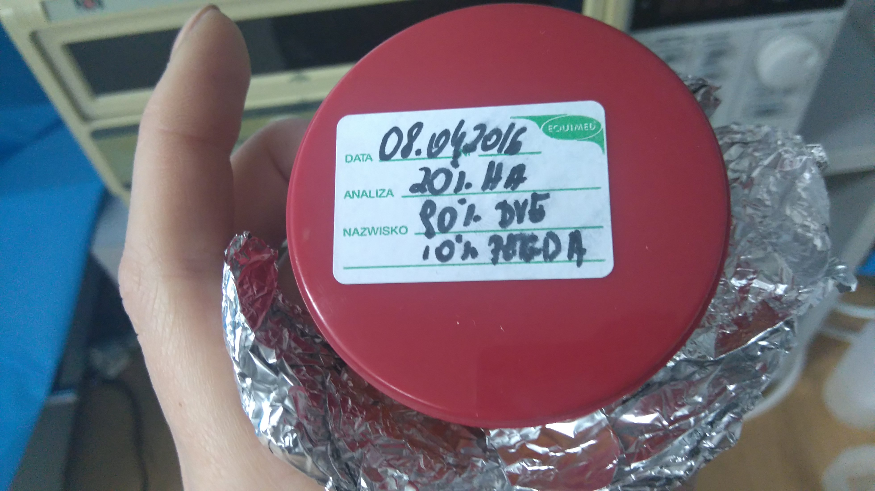

Slide 5
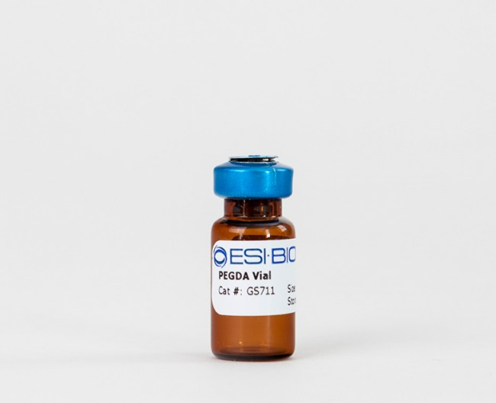
PEGDA
Polyethylene (glycol) Diacrylate

Slide 6
DVA
Adipic acid divinyl ester.

Slide 7
BAPO
Photoiniciator

Slide 8
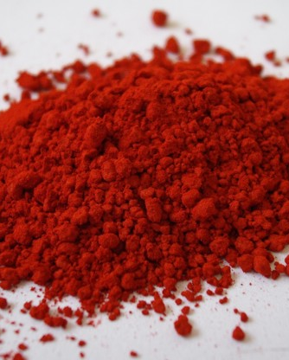
SUDAN I
Organic compound classified as a azo dye.

Slide 9
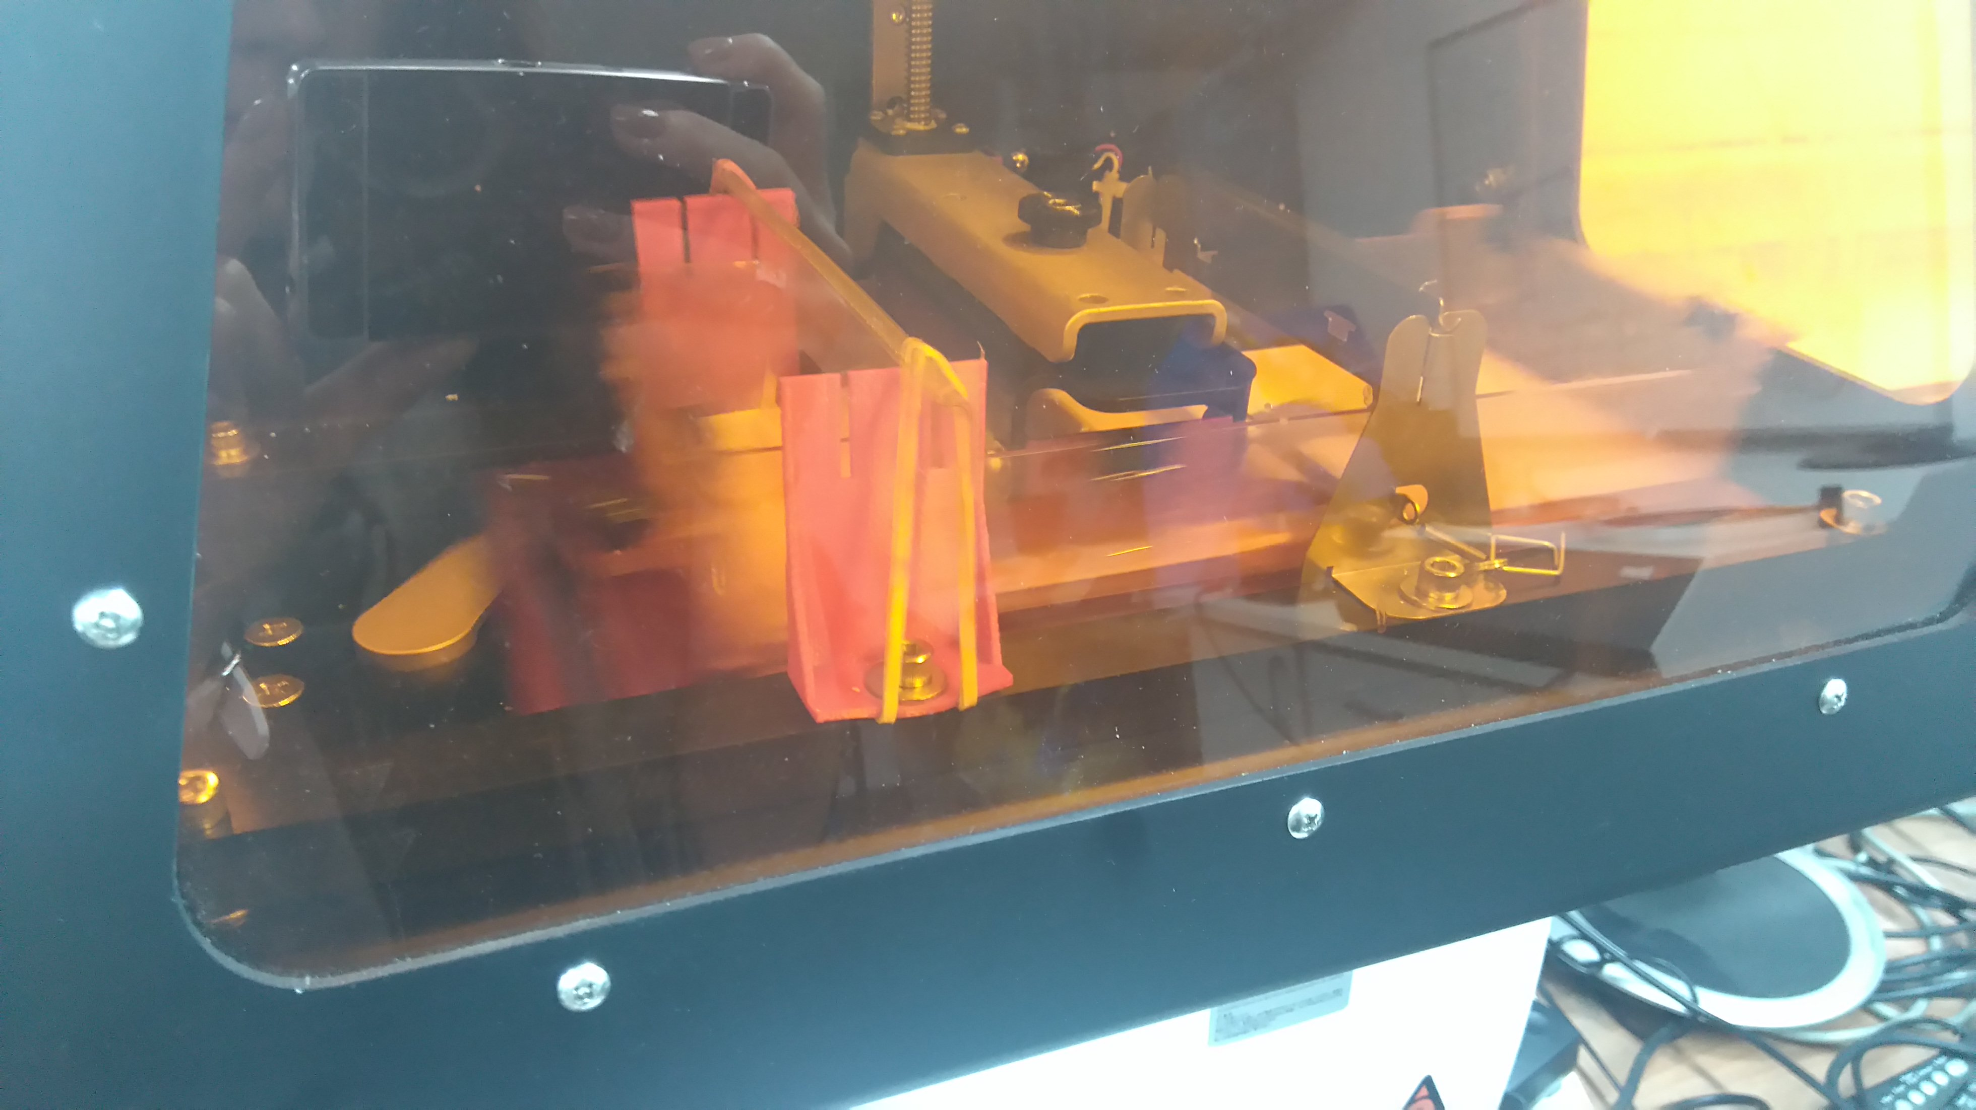

Slide 11
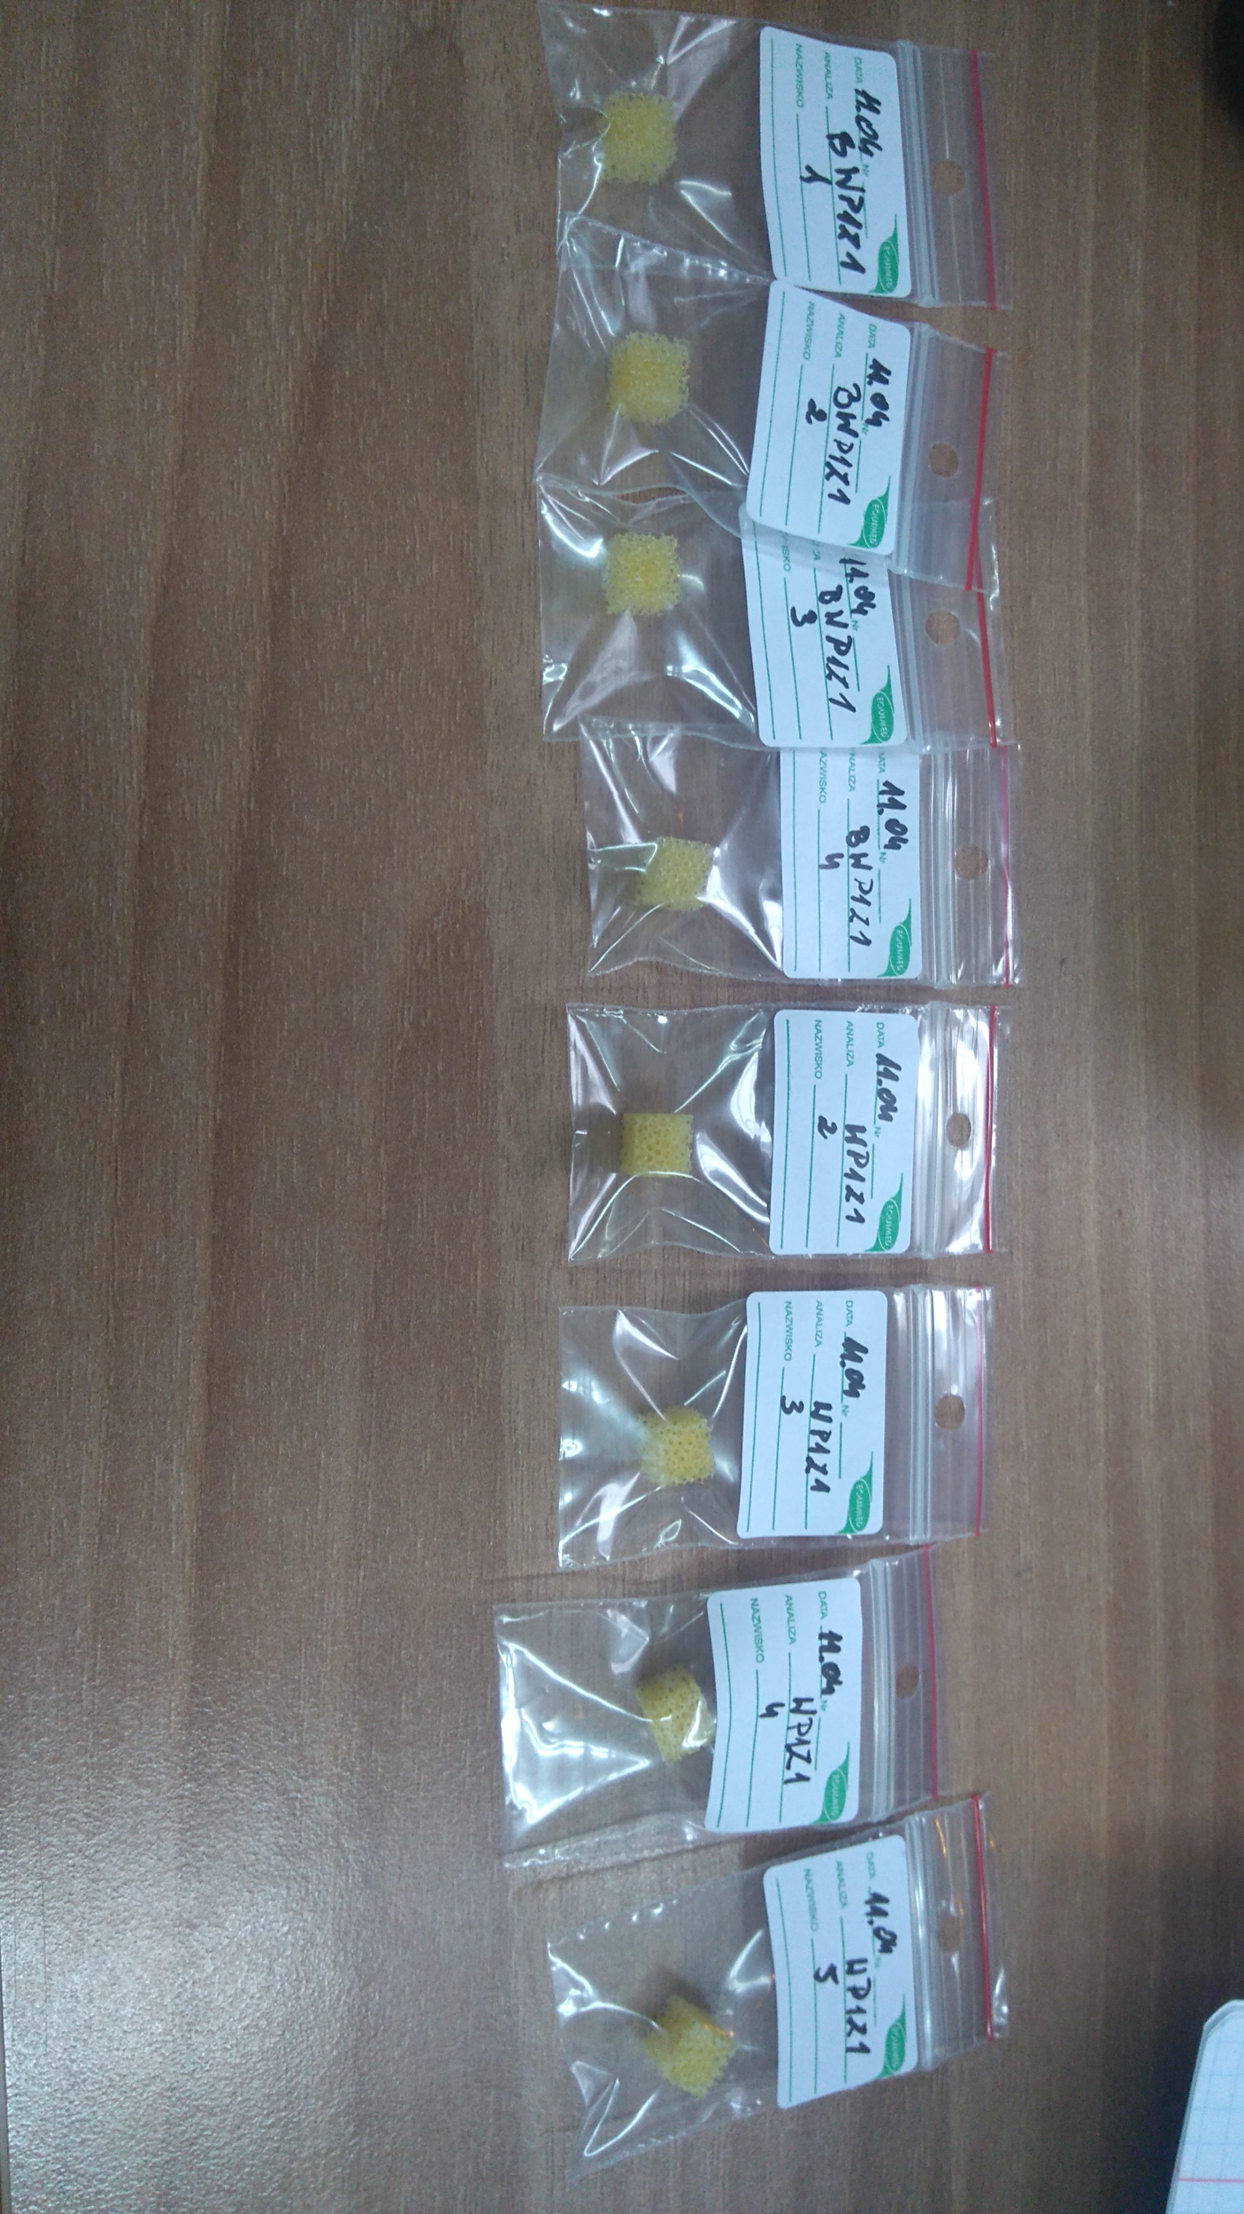

Slide 12
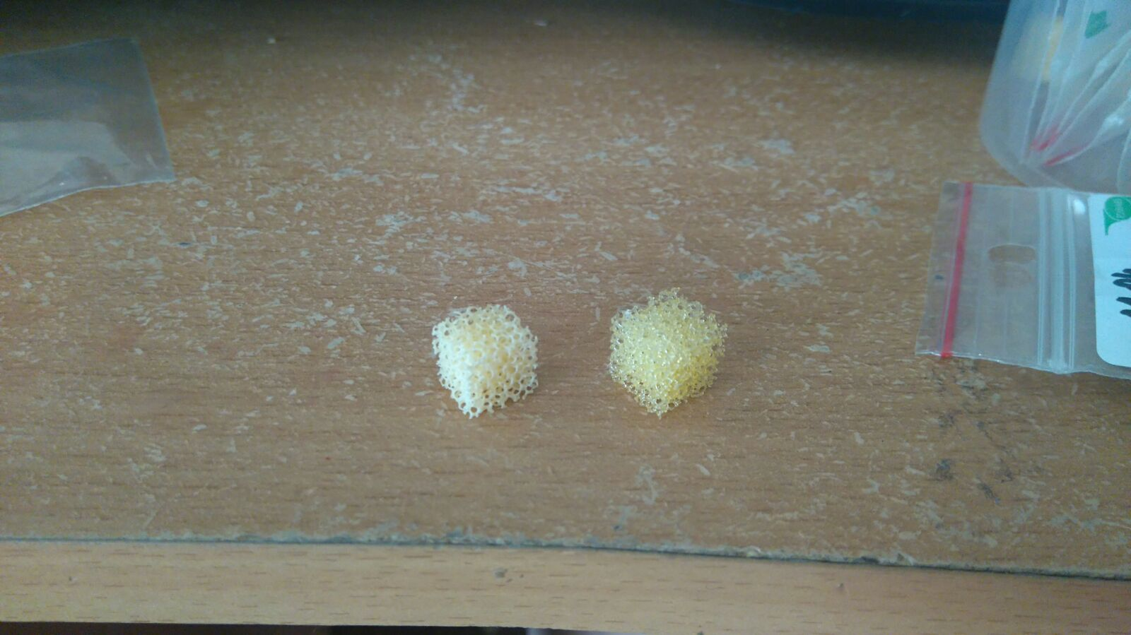
Źródło [16]

Slide 13
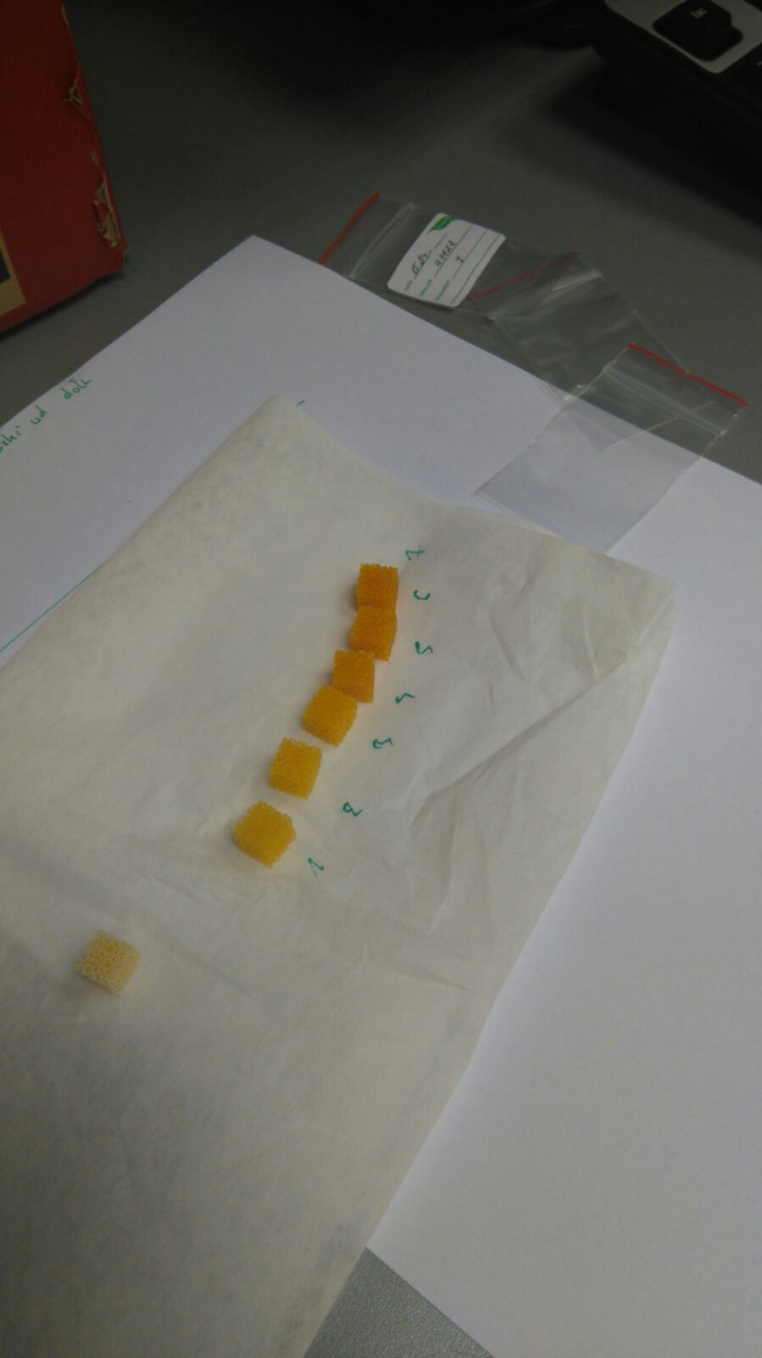

Slide 14
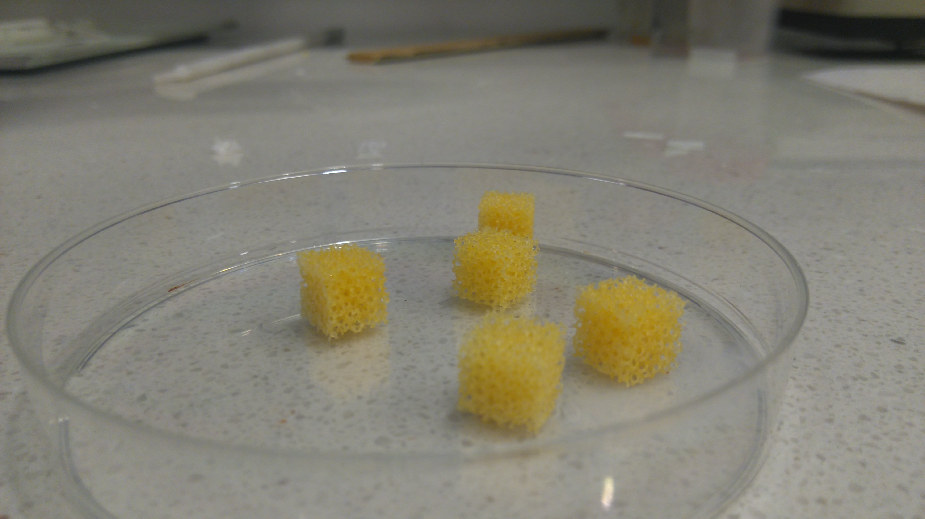

Slide 15
Measurements
Mass
Size
Porosity
Young’s modulus

Slide 16
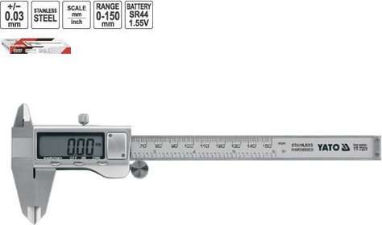
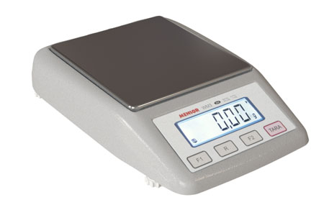

Slide 17
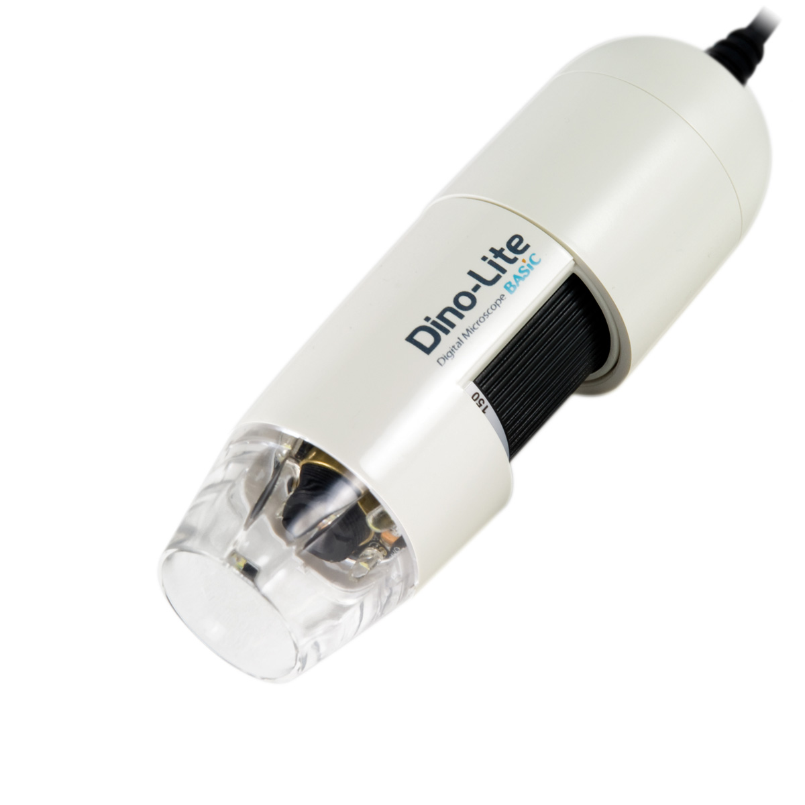

Slide 18
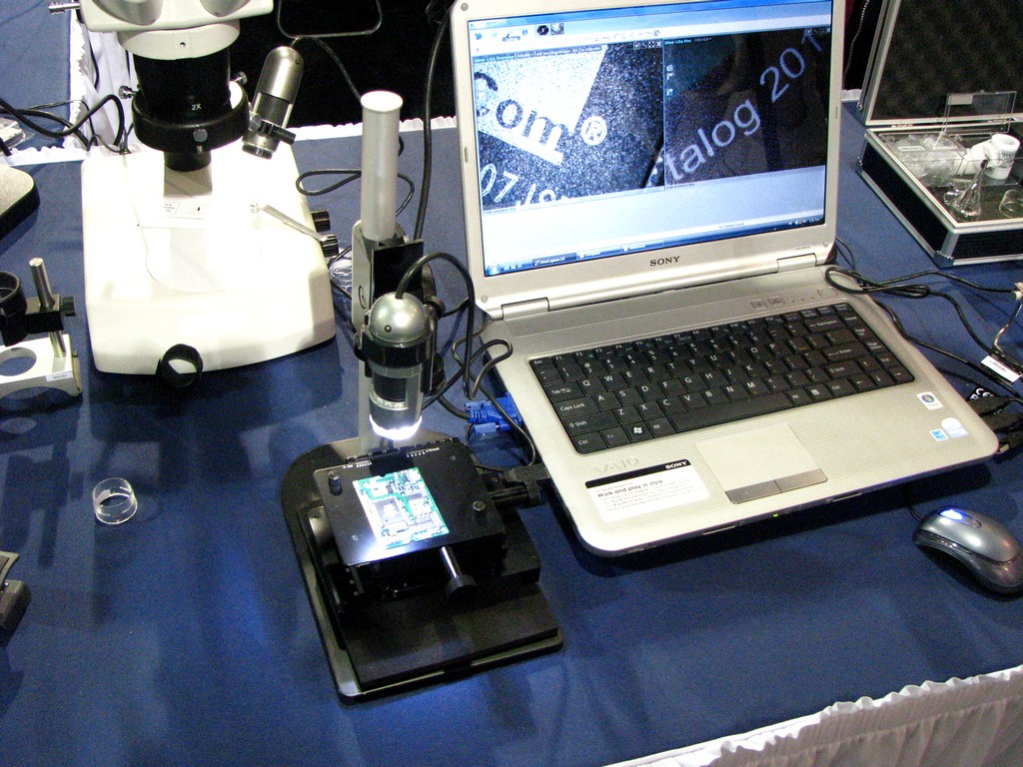

Slide 19
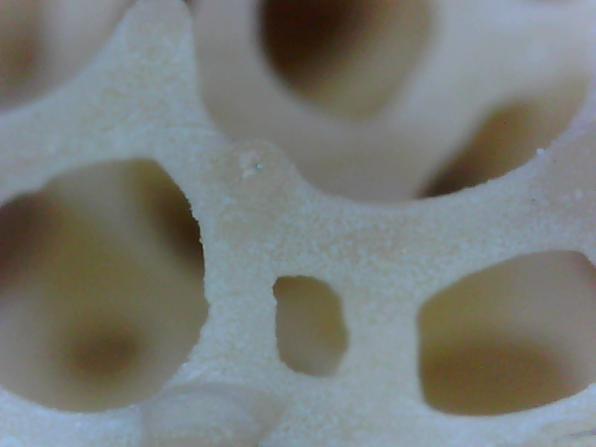
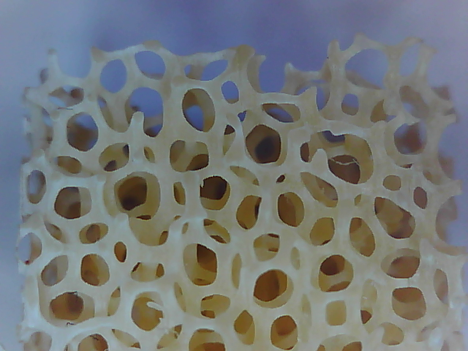

Slide 20
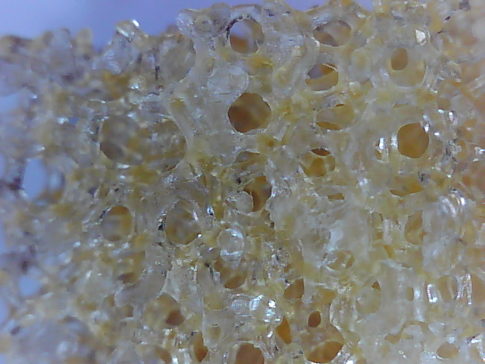
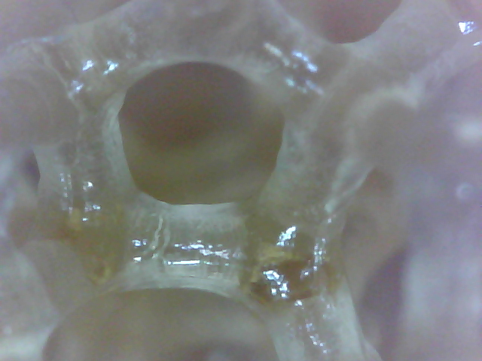

Slide 22
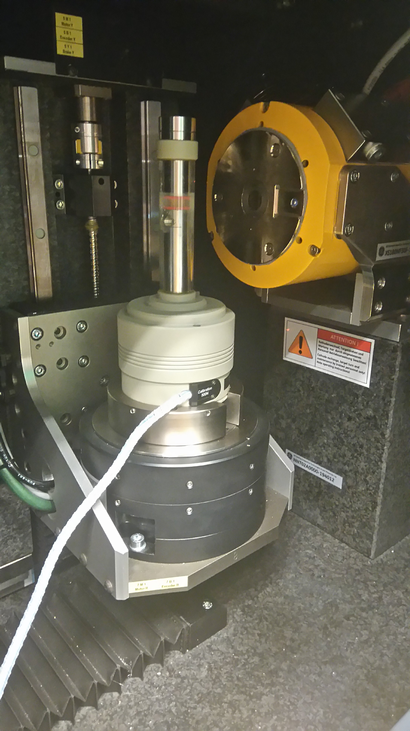

Slide 23
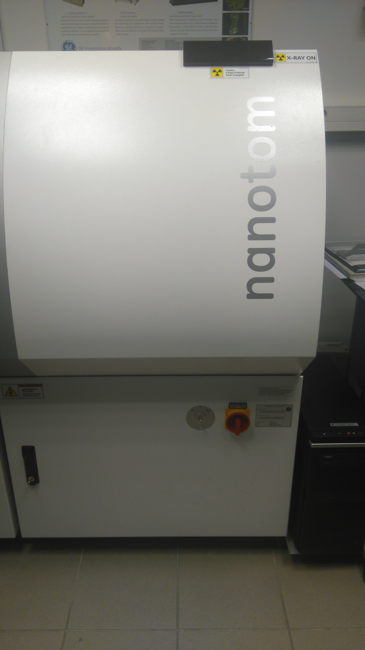

Slide 24
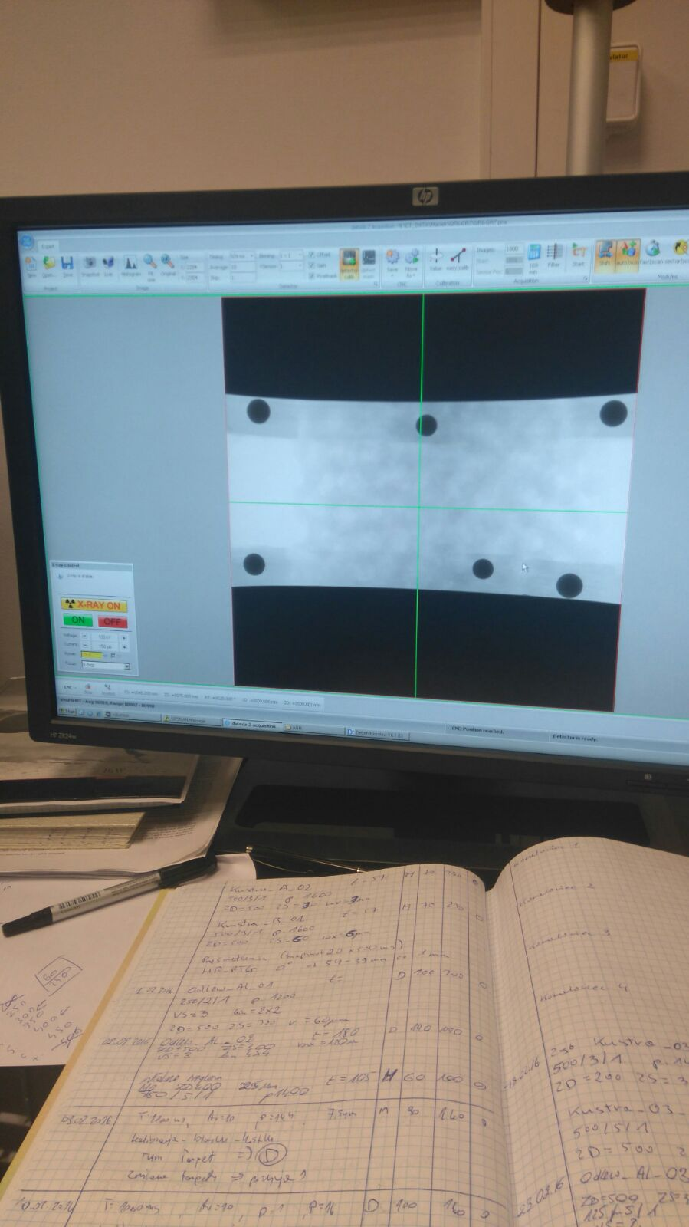

Slide 25
Hydration
Degradation rate
Products of degradation

Slide 26
PBS
Związek | Ilość do dodania (1x) | Końcowa koncentracja (1x) | Ilość do dodania (10x) | Końcowa koncentracja (10x)
H₂O (koniecznie destylowana)
HCl
NaCl | 8g | 137mM | 80g | 1,37M
KCl | 0,2g | 2,7mM | 2g | 27mM
Na₂HPO₄ | 1,44g | 10mM | 14,4g | 100mM
KH₂PO₄ | 0,24g | 1,8mM | 2,4g | 18mM

Slide 27
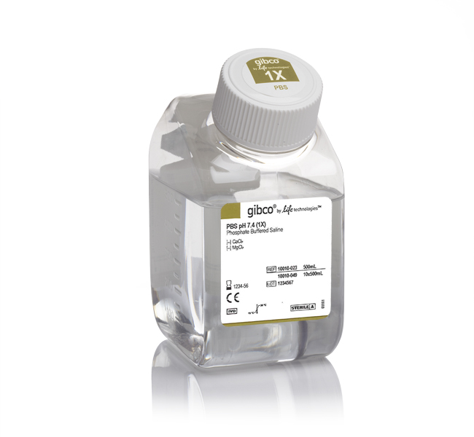
PBS

Slide 28
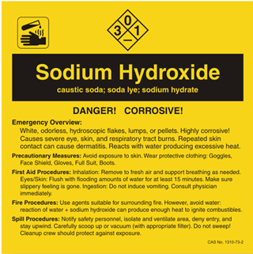
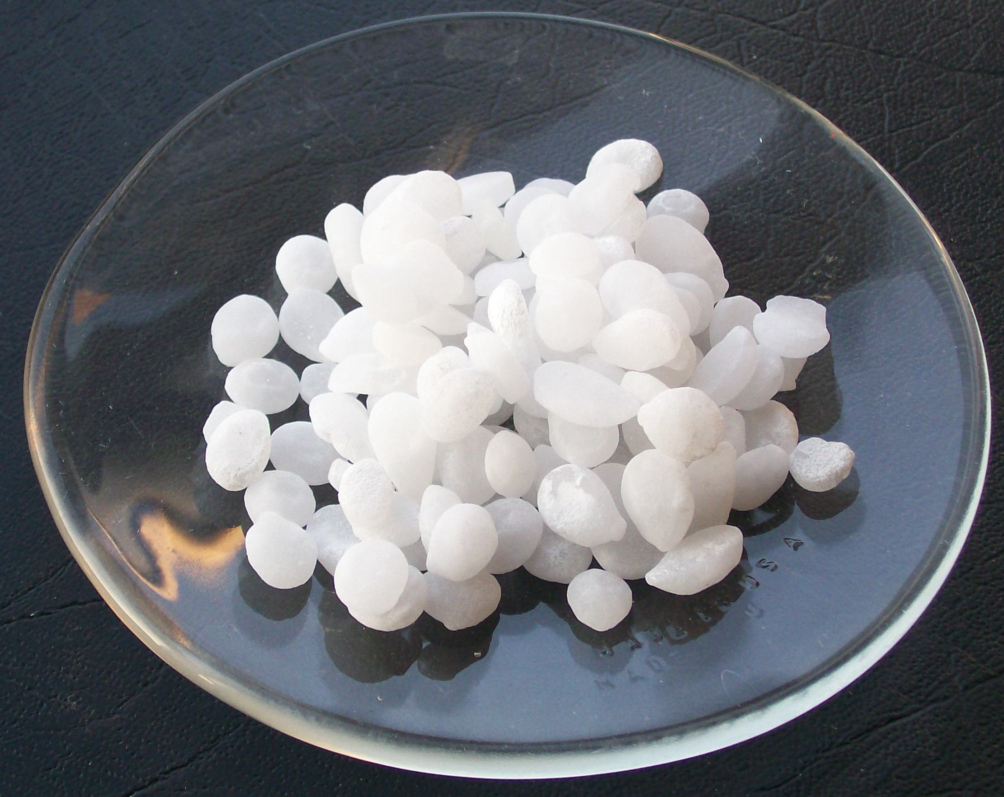
NaOH

Slide 29
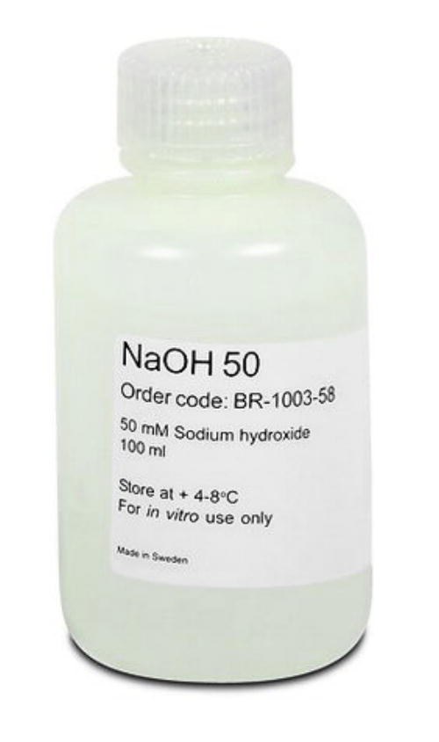
NaOH

Slide 30
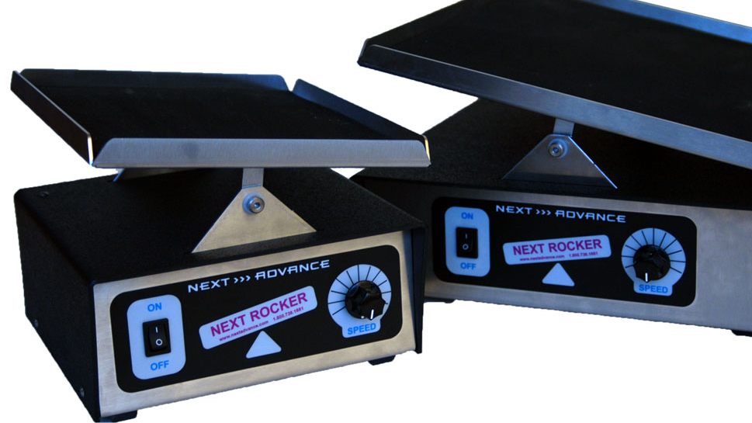
Orbital shaker

Slide 31
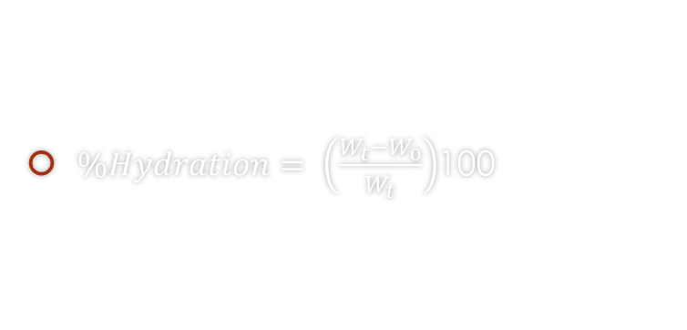
Hydration
$\%Hydration= \left(\frac{W_{t}−W_{0}}{W_{t}}\right)$100

Slide 32
Porosity & Young’s Modulus

Slide 33
Mass & Size

Slide 34

Degradation rate
$D_{R}=\frac{t_{p}}{t_{k}}$

Slide 35
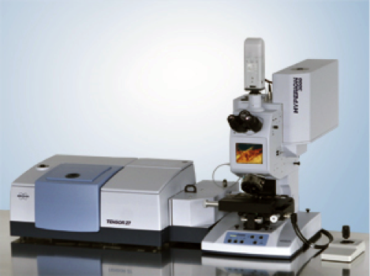
Products of degradation

Slide 36
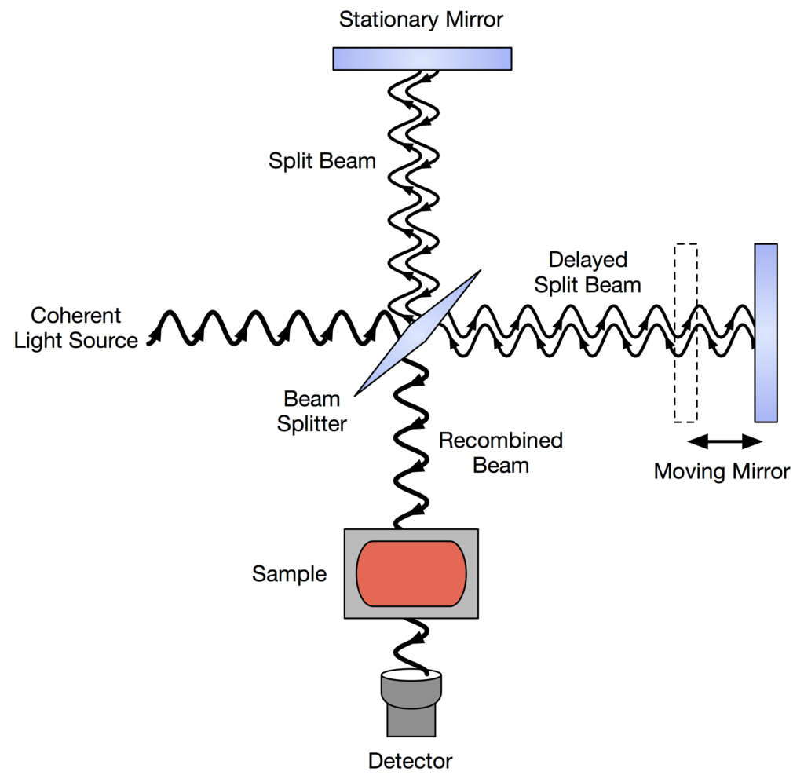
FTIR

Slide 37
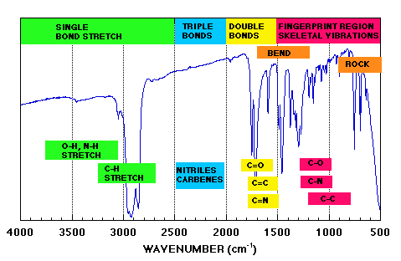
FTIR

Slide 38
Bibliography
Osteoblast, Portal o zdrowiu – www.trialx.com. [Online] [Zacytowano 30 Czerwiec 2011.] http://trialx.com/curetalk/wp-content/blogs.dir/7/files/2011/05/diseases/Osteoblast-3.jpg
Osteoklast, Portal o zdrowiu – homeopathy.at. [Online] [Zacytowano 16 Grudzień 2011.] http://www.homeopathy.at/wp-content/uploads/Osteoklast-2-300x224.jpg
Budowa kości zbitej, Wydawnictwo książkowe - http://www.pearsoned.co.uk. [Online] [Zacytowano 2004] http://mailgrupowy.pl/files/html/693175,index_html_44e6d8c4.jpg
Tadeusz Cichocki, Kompendium histologii, 2002
Budowa nasady kości udowej, Wikipedia - http://pl.wikipedia.org/wiki/Krętarz_mniejszy [Online] [Zacytowano 2014] http://upload.wikimedia.org/wikipedia/commons/thumb/0/08/Superior_epiphysis_-_posterior_view.jpg/220px-Superior_epiphysis_-_posterior_view.jpg
Yuehuei H. An, Mechanical Testing of Bone and the Bone-Implant Interface, 2000
Arturo N. Natali, Dental Biomechanics, 2003
Alejandro A. Espinoza Orías, The relationship between the mechanical anisotropy of human cortical bone tissue and its microstructure, 2005
Richard B. Ashman, Elastic Modulus of trabecular bone material, 1988
Benedikt Helgason, Egon Perilli, Enrico Schileo, Mathematical relationships between bone density and mechanical properties: A literature review, 2007
Esther Cory, Ara Nazarian, Vahid Enezari, Vartan Vartanians, Compressive axial mechanical properties of rat bone as functions of bone volume fraction, apparent density and micro-ct based mineral density, 2009
Dieter Christian Wirtz, Norbert Schiffers, Thomas Pandorf, Klaus Redermacher, Dieter Weichert, Raimund Forst, Critical evaluation of known bone material properties to realize anisotropic FE-simulation of the proximal femur, 2000
J. Halgrin, F. Chaari, E. Markiewicz, On the effect of marrow in the mechanical behavior and crush response of trabecular bone, 2011
Jerzy Litniewski, Wykorzystanie fal ultradźwiękowych do oceny zmian struktury kości gąbczastej, 2006
Wykład prof. dr hab. Inż Krzysztofa Wierzbanowskiego Naprężenia I odkształcenia
Susan L. Ishaug-Riley, Bone Formation by three-dimensional osteobast culture in biodegradable scaffolds, 1997

Slide 39

Thank you

